Slide 1
Crowding test result so far
For young and aged
Jiahan 202409

Slide 2
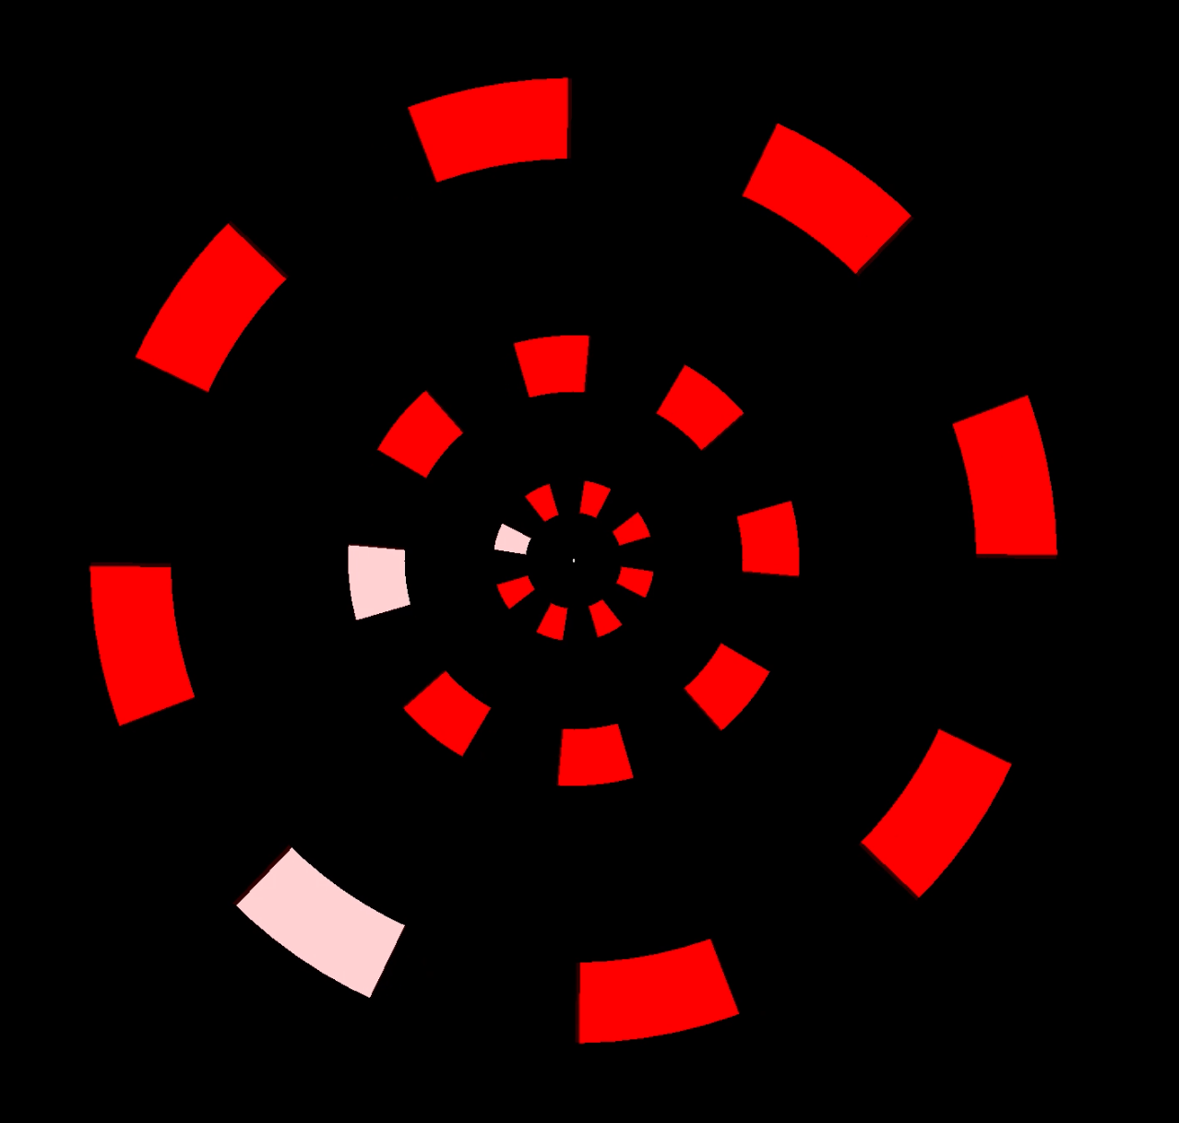
Aim of crowding test
-----Explain if there is any difference in temporal limits in multiple object tracking experiment

Slide 3


Crowding test stimulus demo
Acuity test
Crowding test

Slide 4
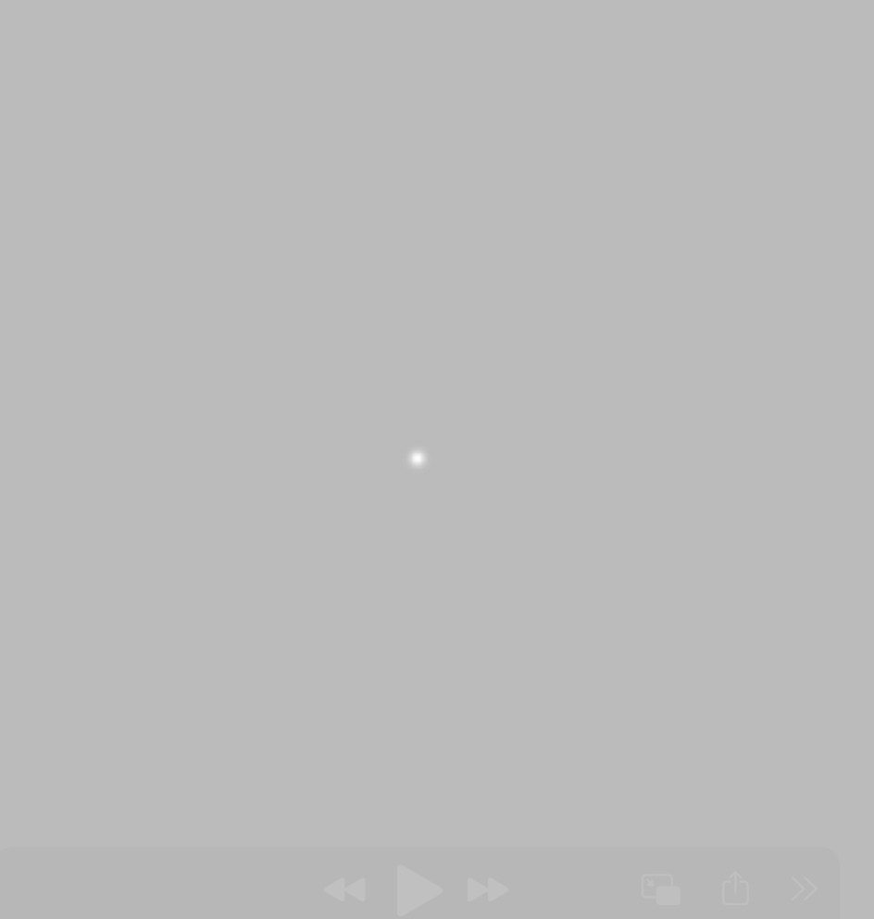
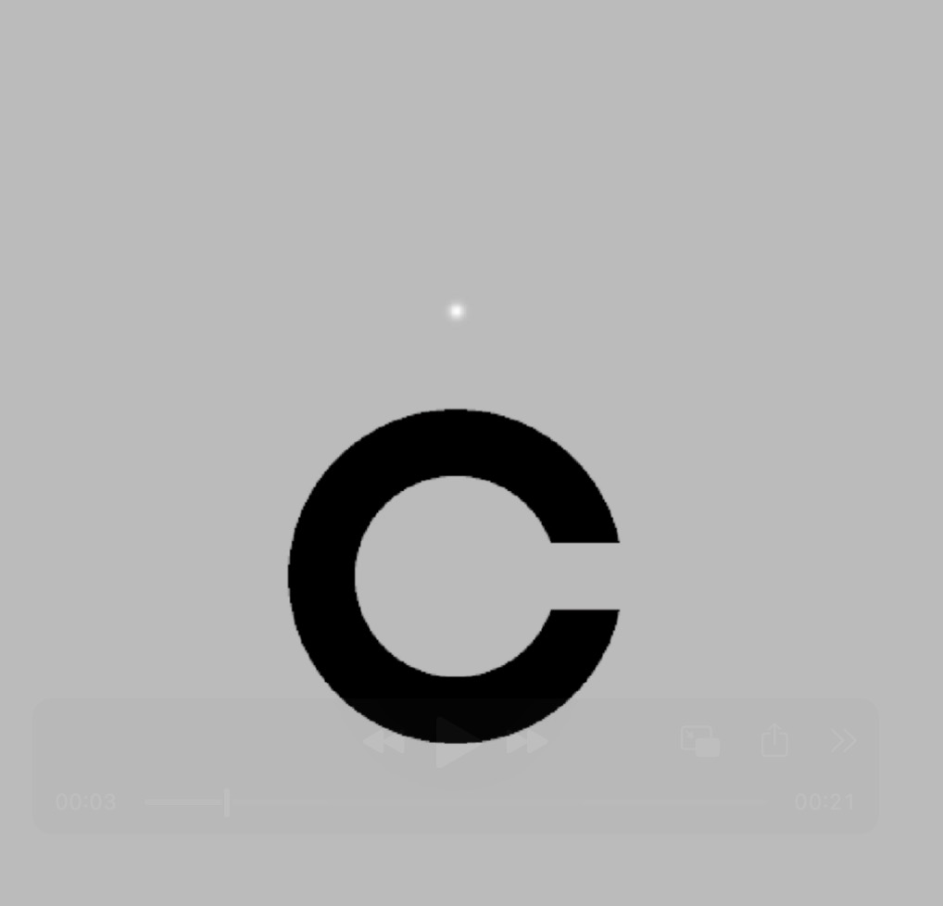

Acuity test
500 ms
300 ms
Time
Crowding test

Slide 5
Gap threshold
Gap threshold ✖️ 5 = Diameter
Diameter
Diameter ✖️ 1.1 = Center-to-center spacing
Center-to-Center spacing
6.1°

Slide 6
Different stimulus parameters
 |  | Young | Old | Total
a | All data | 10 | 21 | 31 | All the data we collected
b | Longer presenting time | 0 | 3 | 3 | At the beginning of the experiment, we present the stimulus for 500ms
c | Too short presenting time | 0 | 1 | 1 | For one aged participant, we present the stimulus for 200ms and she report could see nothing in acuity test, so we present the stimulus for 300ms in her crowding test
d | Exceeded crowding test threshold | 2 | 3 | 5 | The participants' crowding test thresholds exceeded the maximum gap setting allowed in our experiment
e | Exceeded acuity test threshold | 0 | 1 | 1 | The participants' acuity test thresholds exceeded the maximum gap setting allowed in our experiment
f | With mask | 0 | 8 | 8 | The mask erases memory after the stimulus
g | Perfect fixation for aged | 8 | 2 | 10 | The elderly participant maintained perfect fixation, as confirmed by manually checking the fixation using the Eyelink fixation plot
h | Processed data after all exclusions | 8 | 5（include 2 aged with perfect fixation） | 13 | After all exclusions

Slide 7
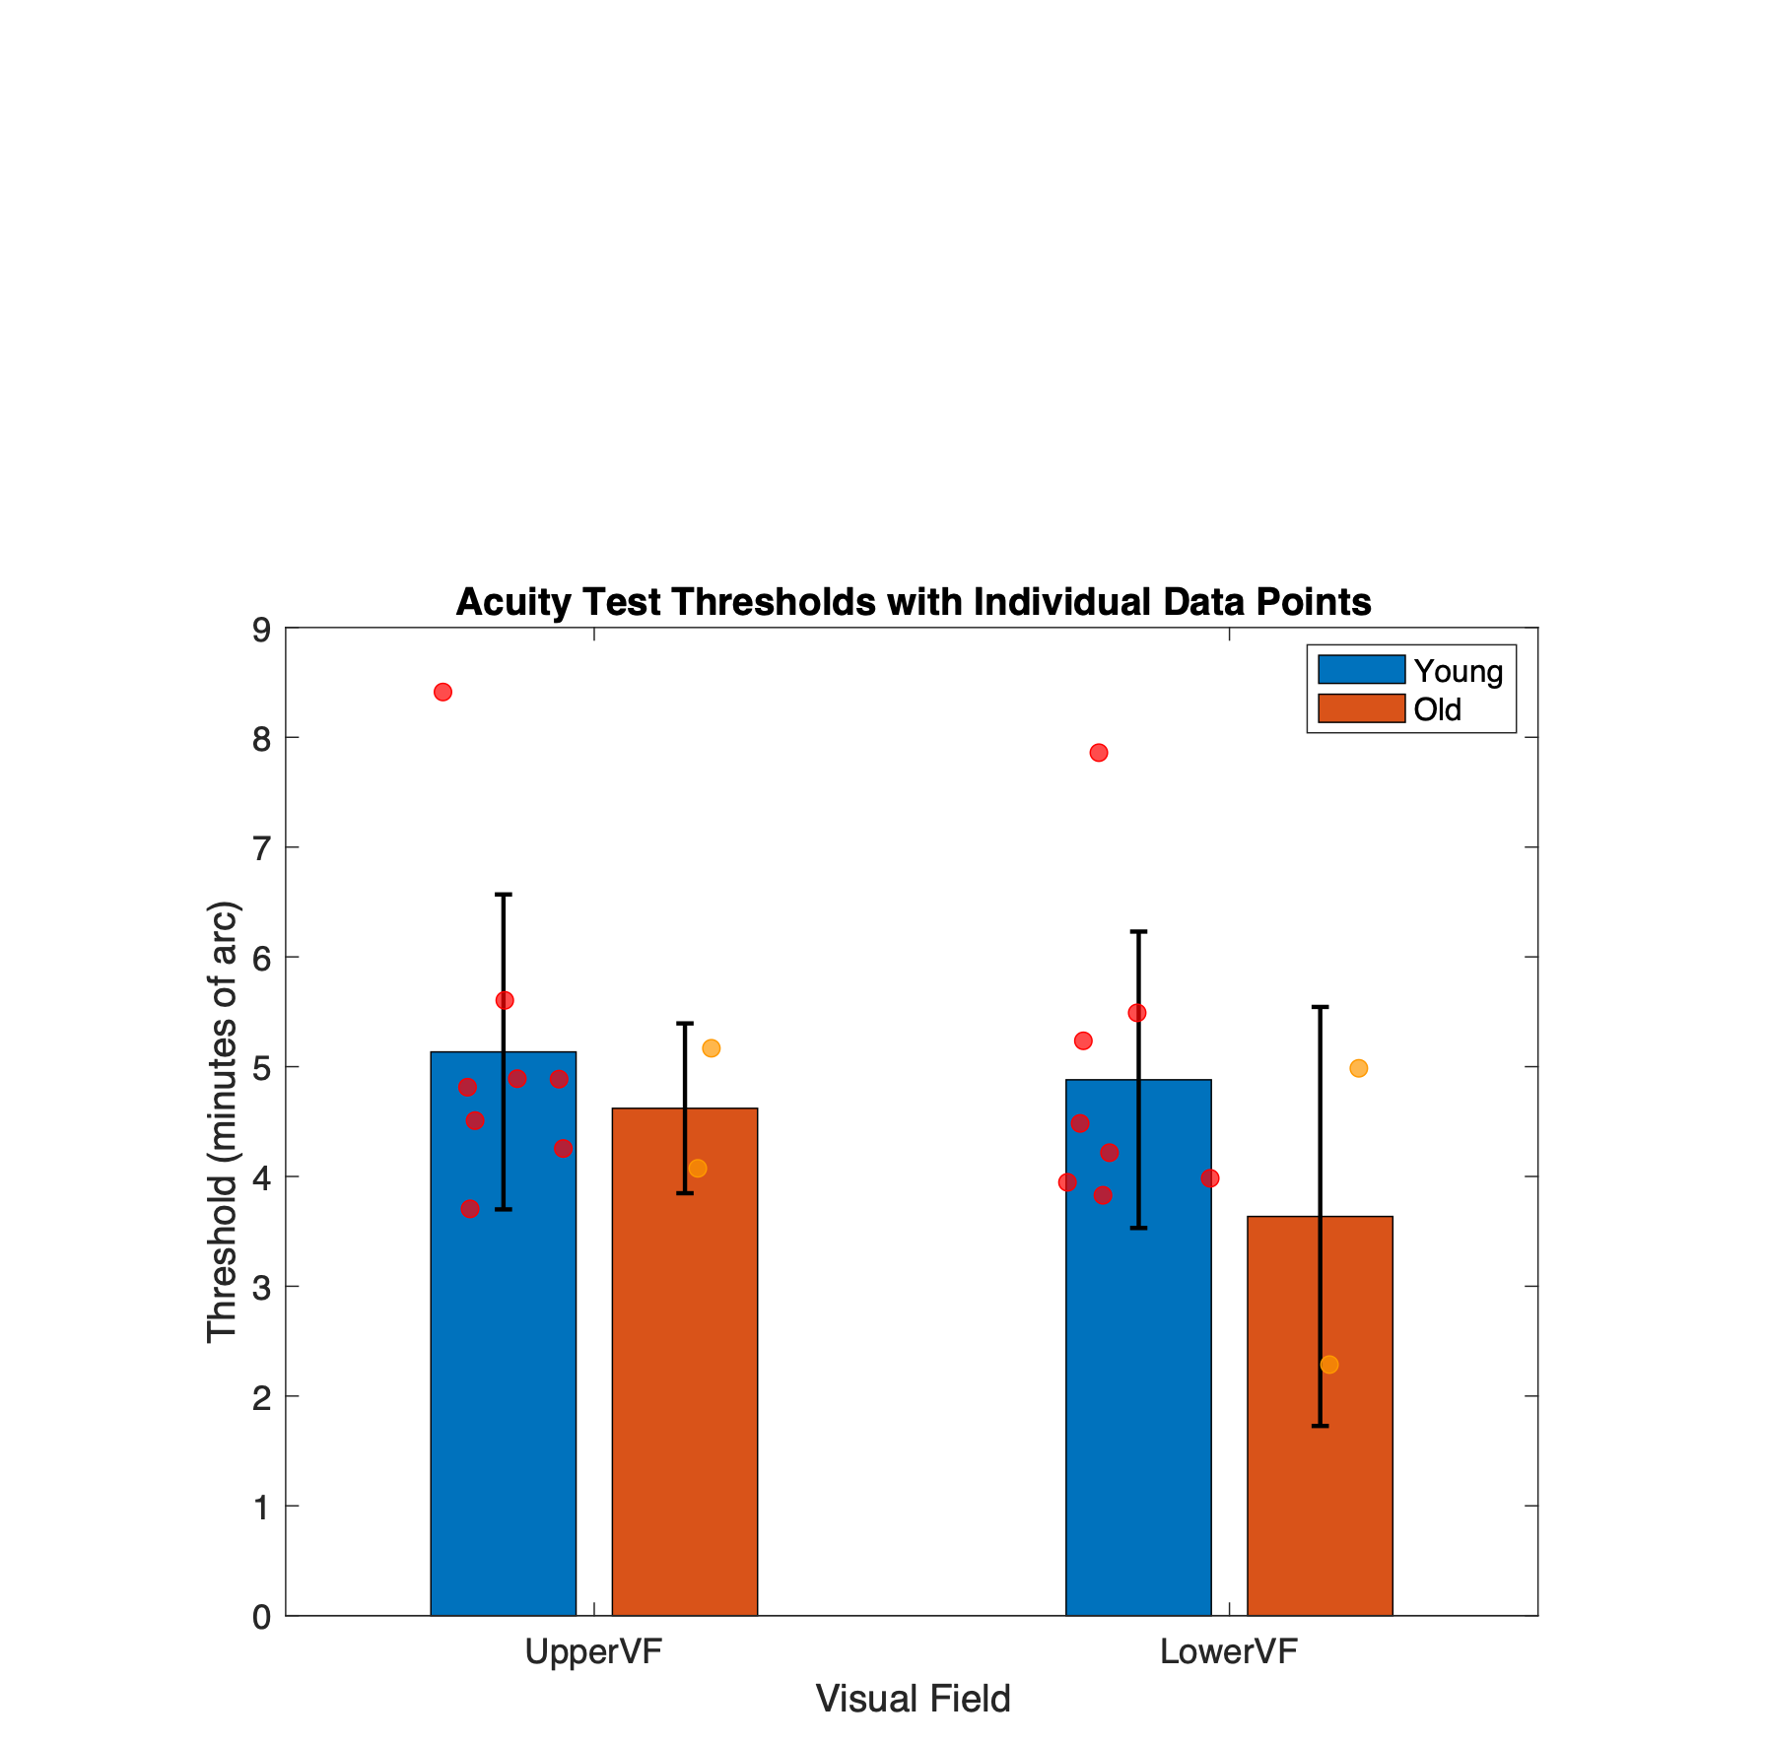
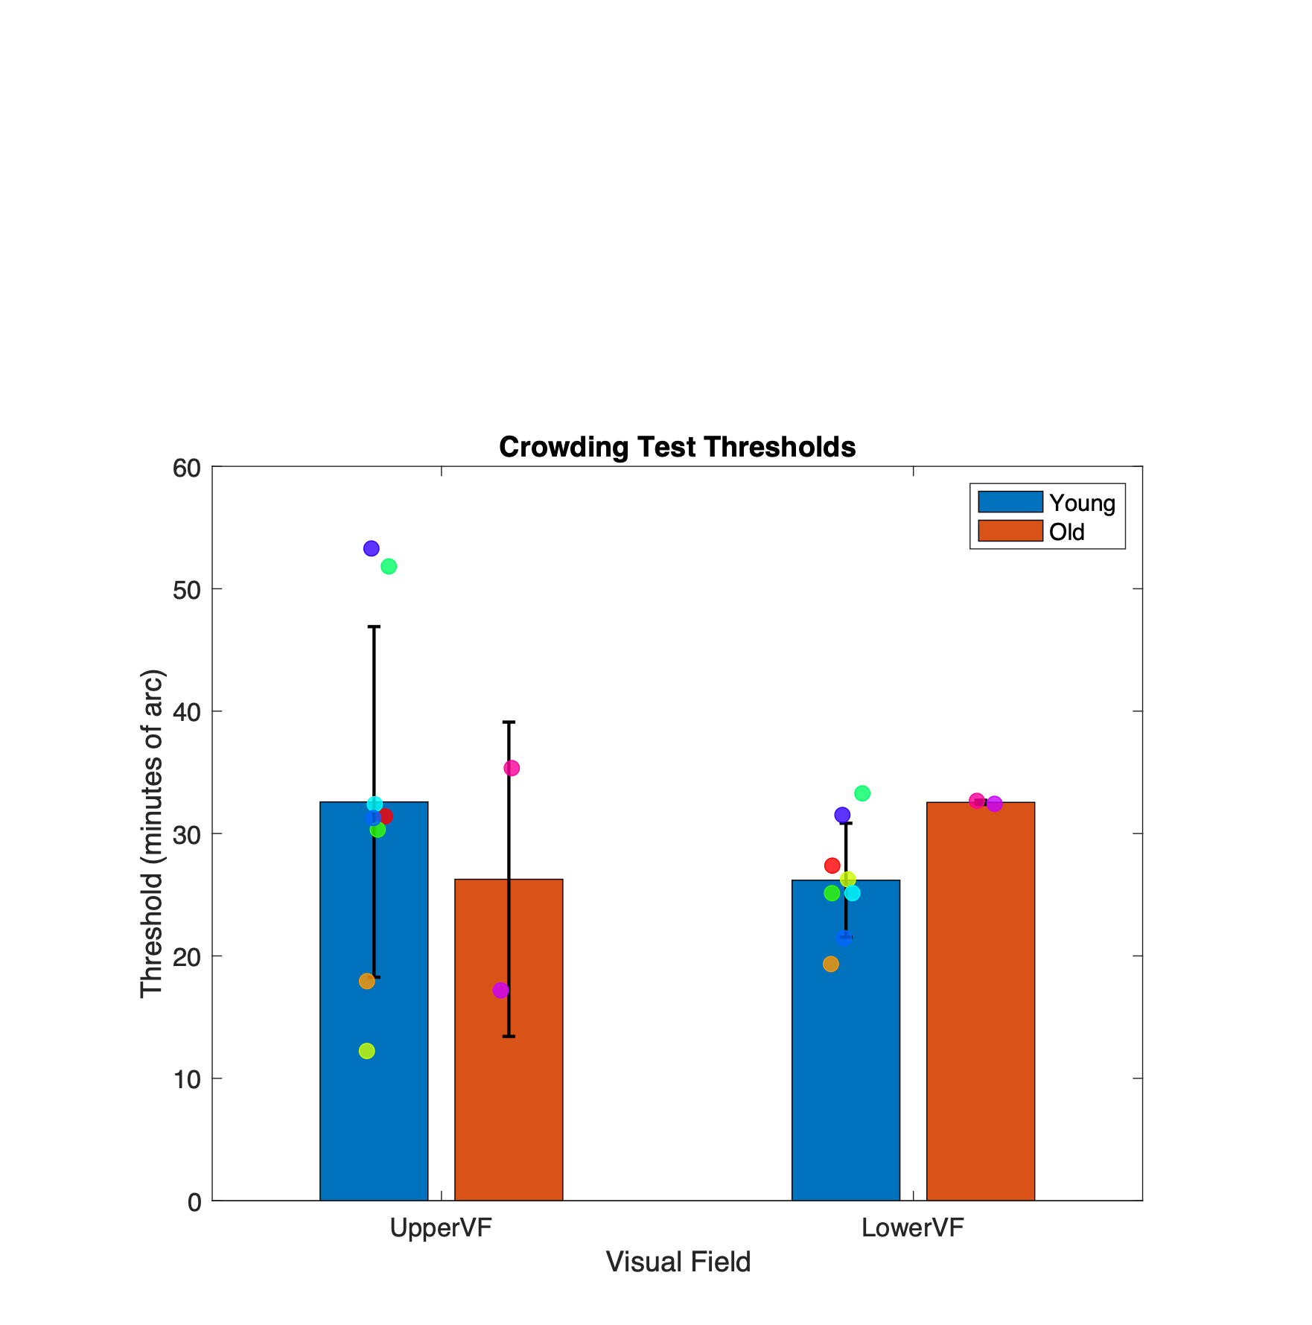
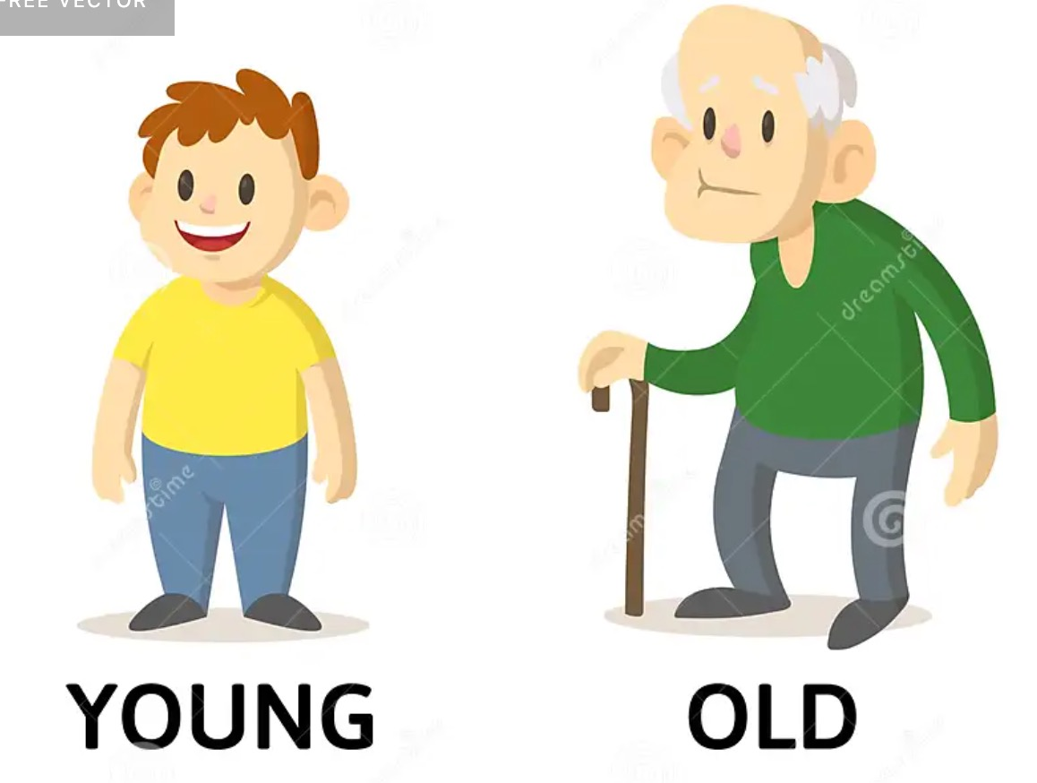
Results
Data for row g, 8 young and 2 aged with perfect fixation
= 8
= 2

Slide 8
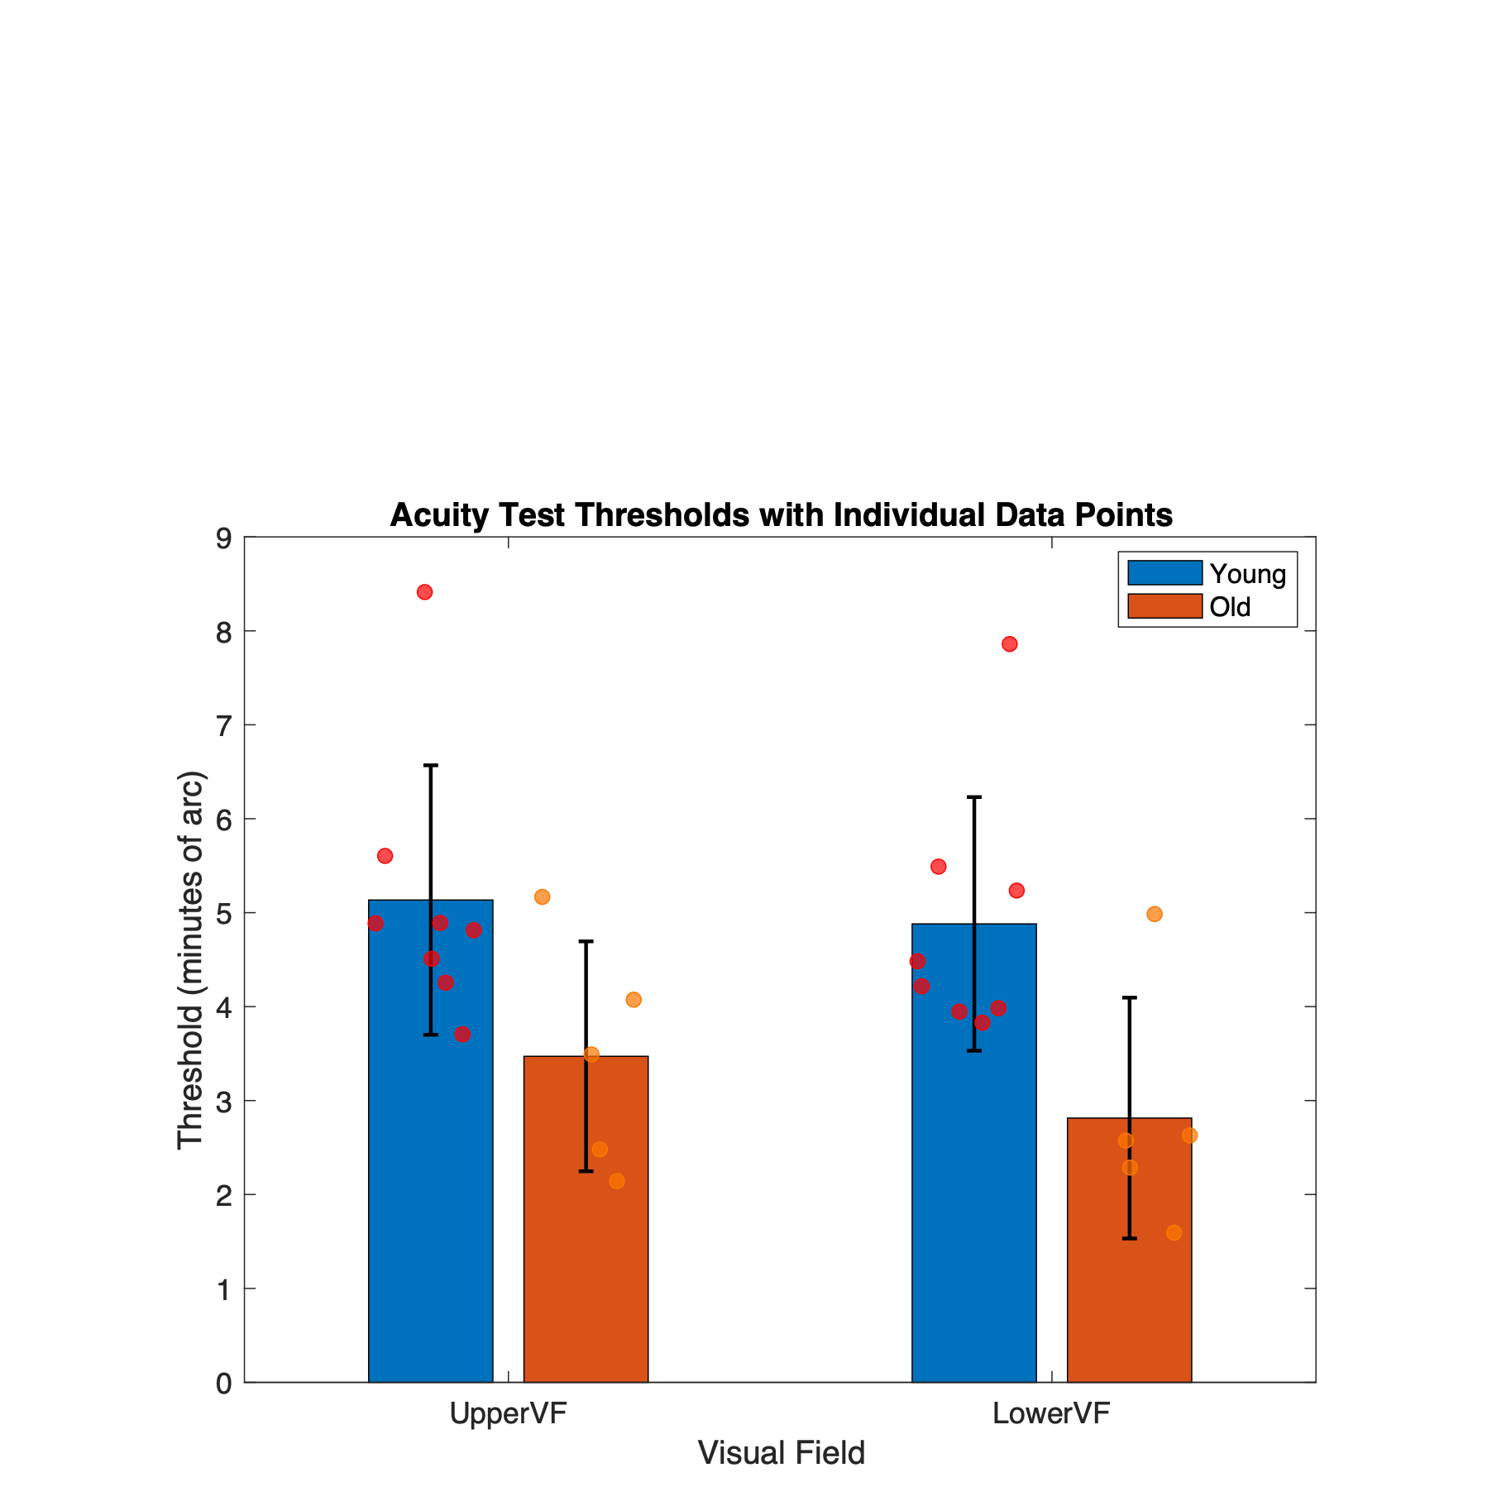
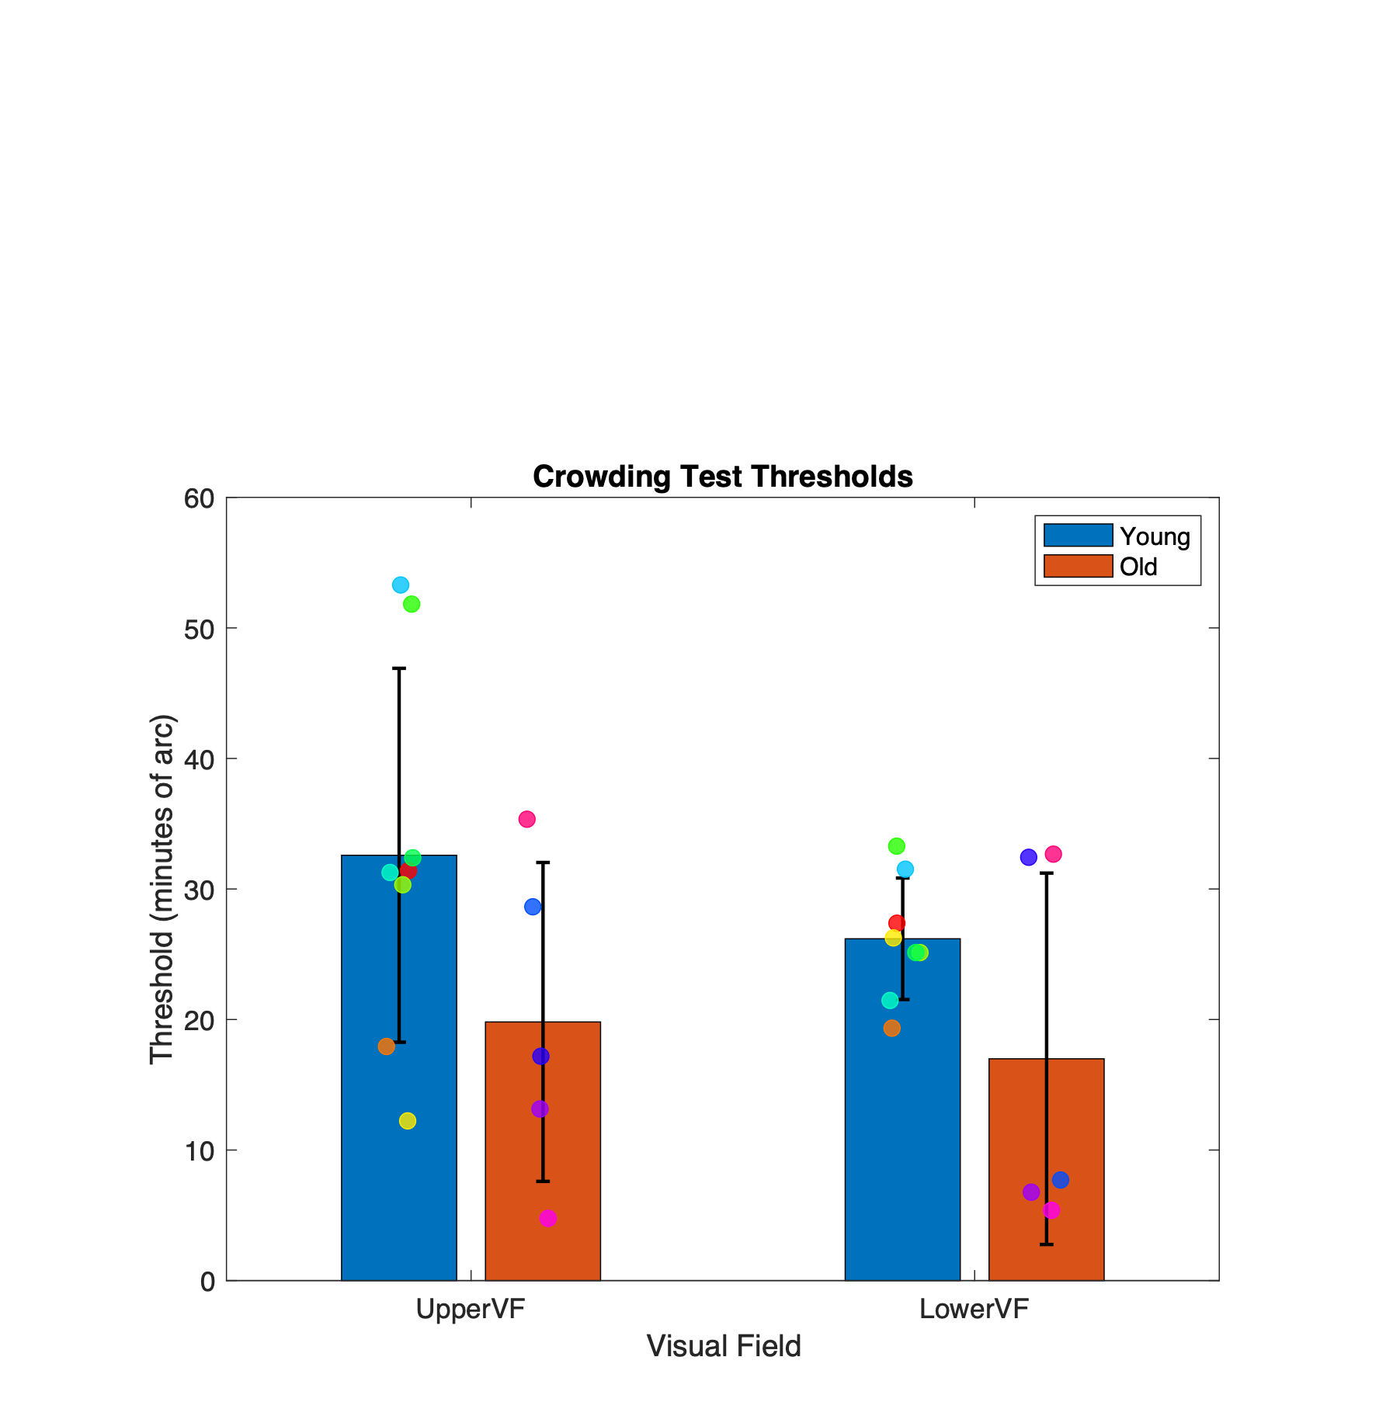
Results
Data for row h, with 8 young and 5 aged even with not good fixation
= 8
= 5
*

Slide 9
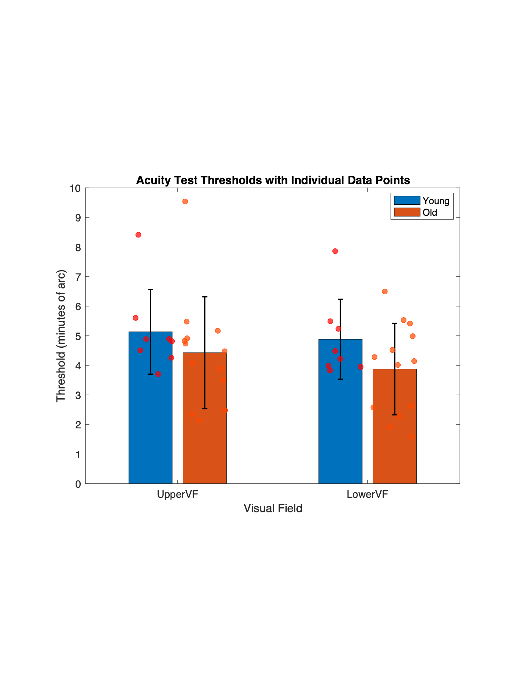
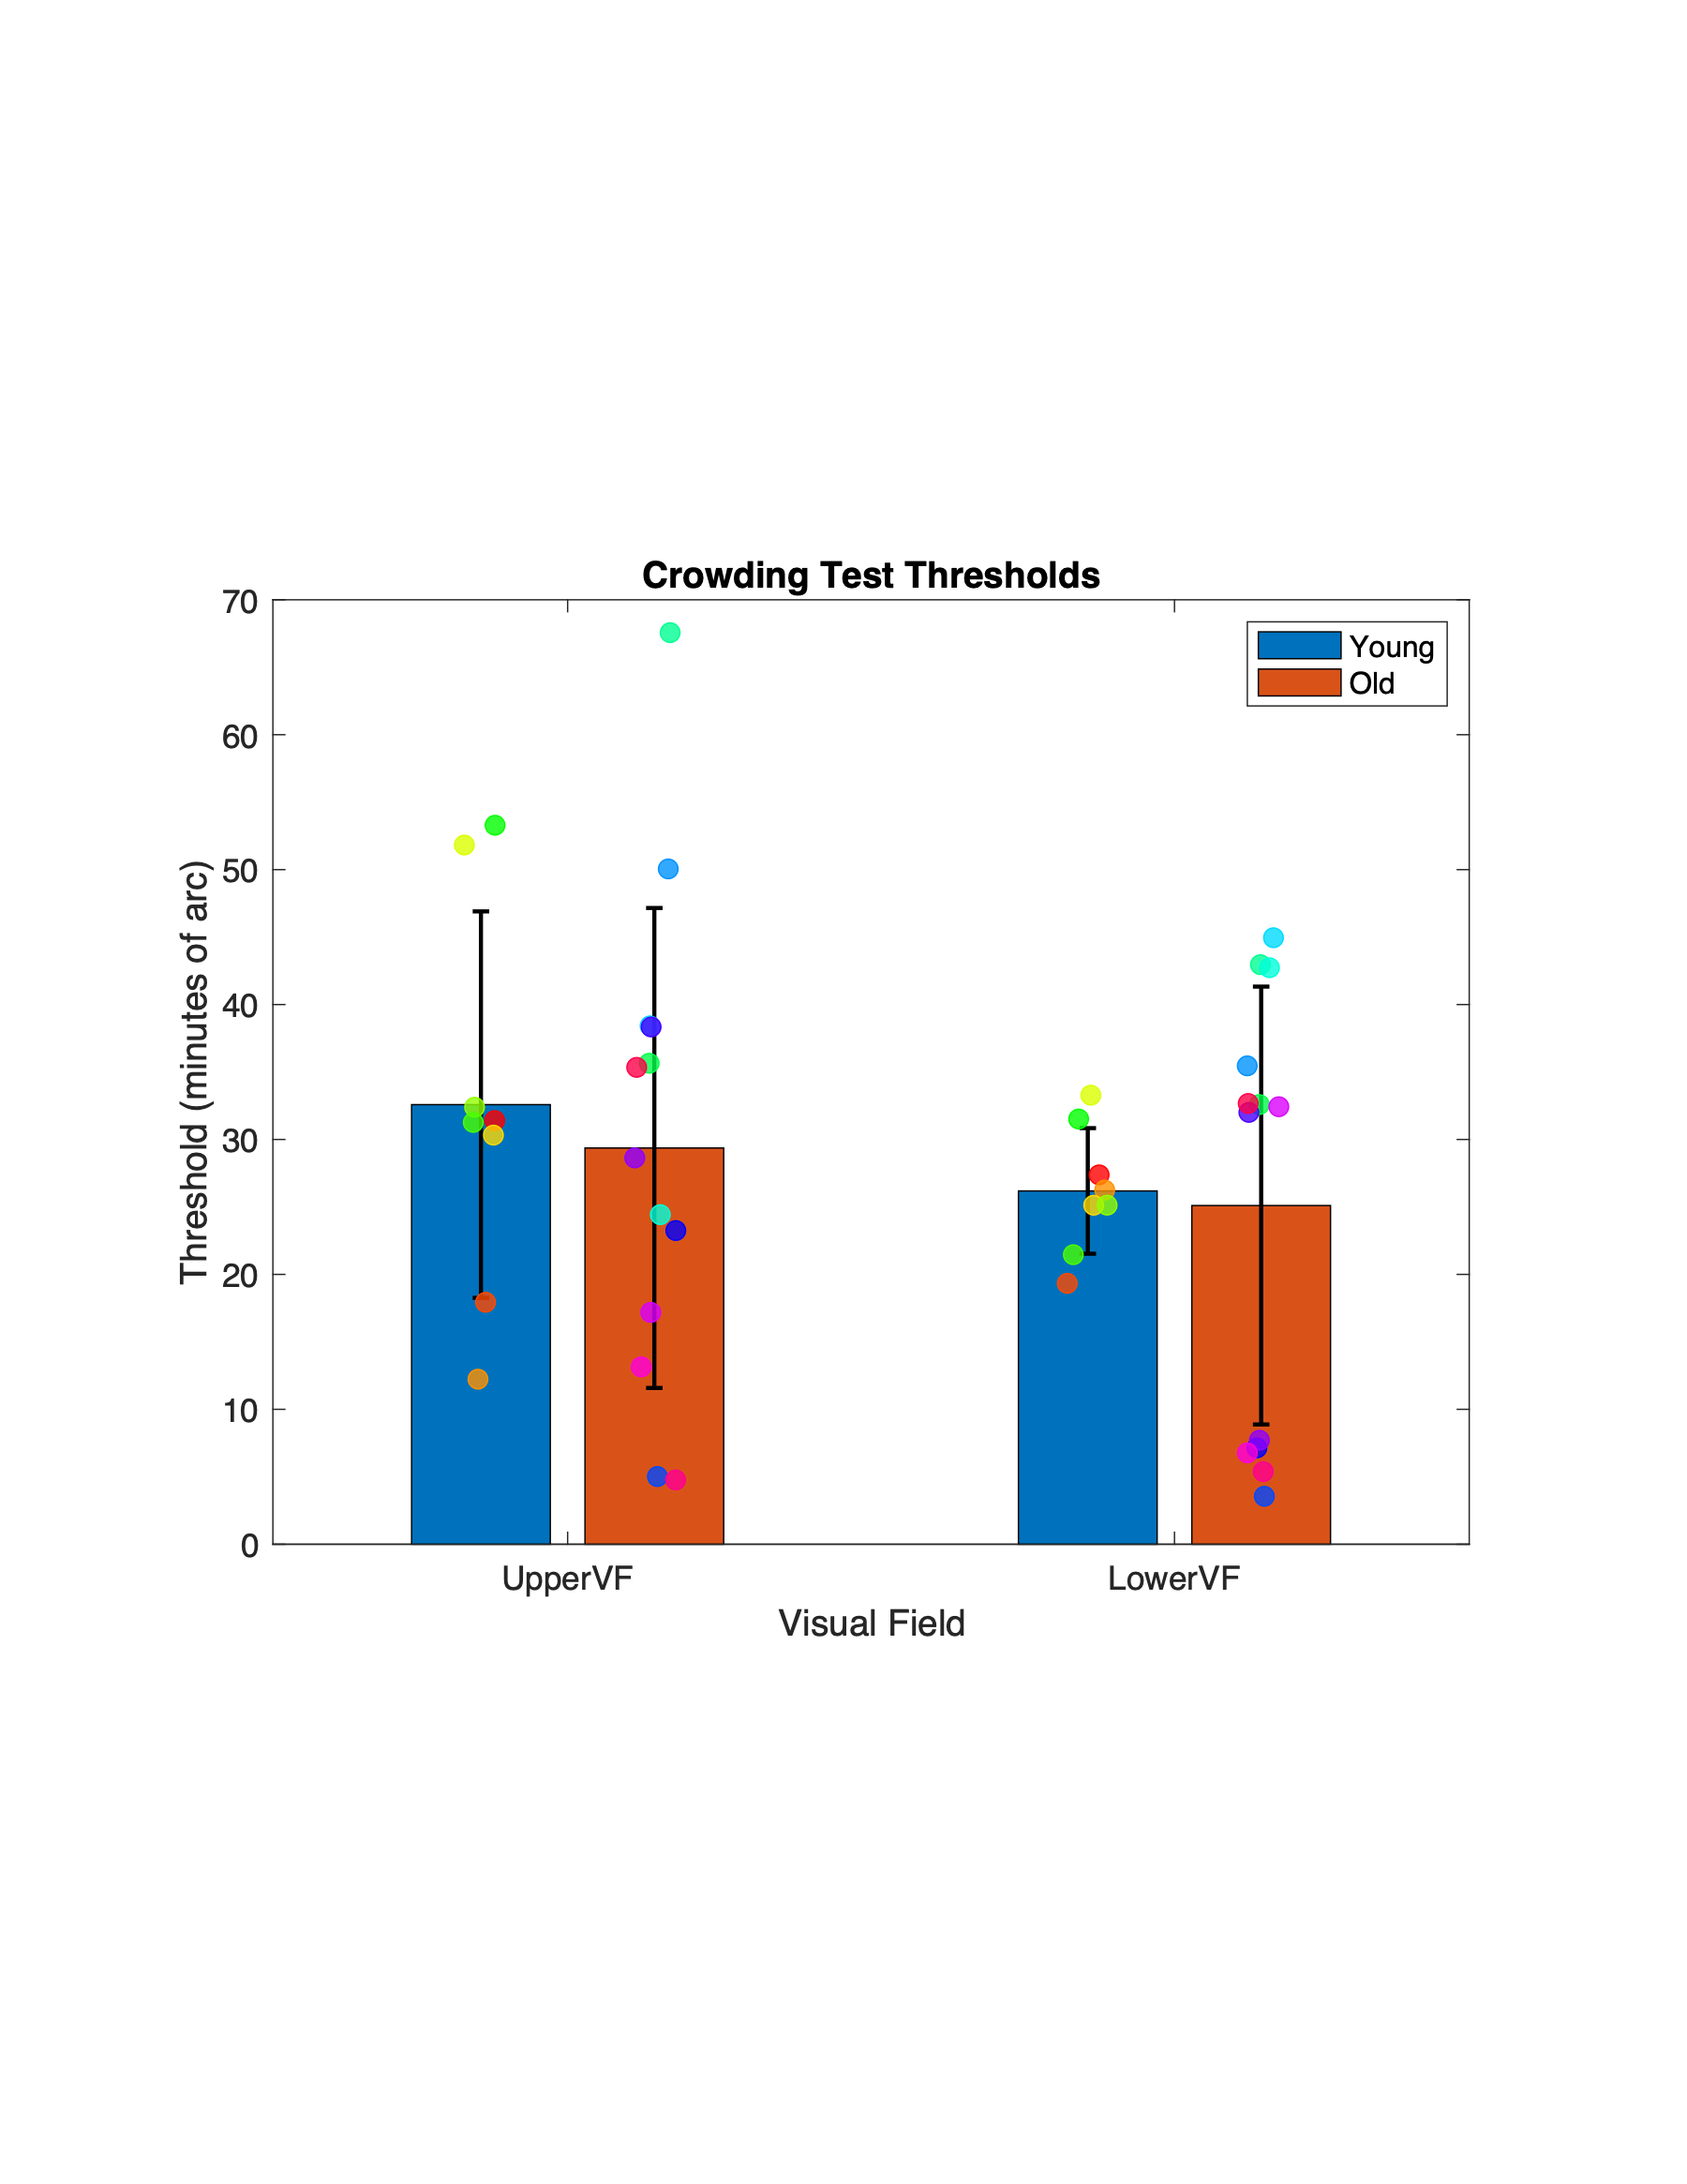
Results
Data exclude row b c d e (include 8 young and 13 aged with after stimulus masks)
= 8
= 13

Slide 10
Results
Data exclude row b c d e (include 8 young and 13 aged with after stimulus masks)
= 8
= 13

Slide 11
Future research
Eye gaze
Attention
500 ms
50 ms
300 ms
Time

Slide 12

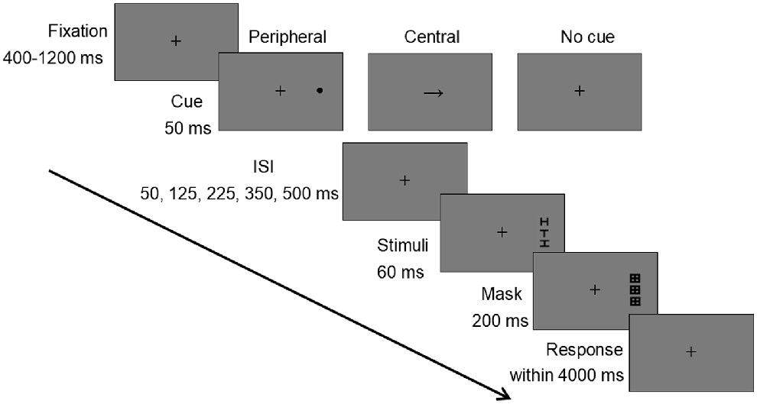
From: Attention relieves visual crowding: Dissociable effects of peripheral and central cues
Journal of Vision. 2023;23(5):9. doi:10.1167/jov.23.5.9
Figure Legend:
The procedure of Experiment 1.
Date of download: 10/14/2024
The Association for Research in Vision and Ophthalmology Copyright © 2024. All rights reserved.

Slide 13
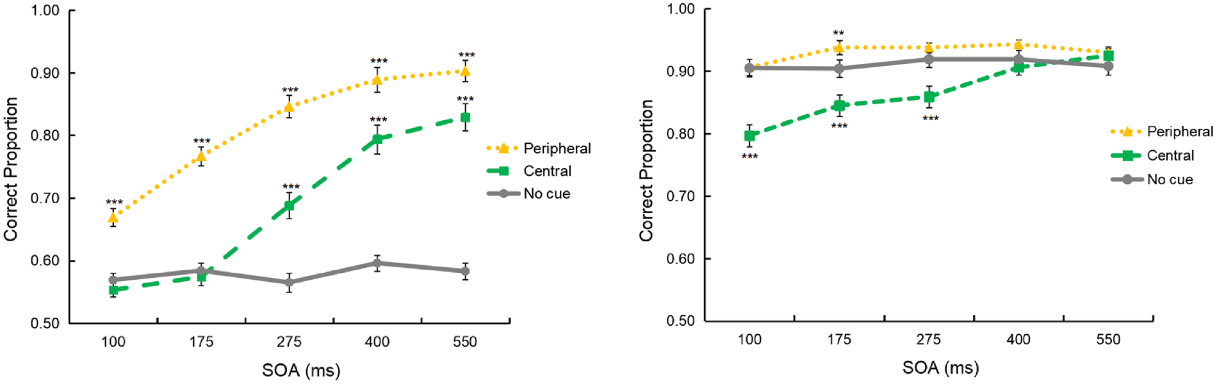
From: Attention relieves visual crowding: Dissociable effects of peripheral and central cues
Journal of Vision. 2023;23(5):9. doi:10.1167/jov.23.5.9
Figure Legend:
Accuracy in Experiment 1, in which predictive validity was 100%. The two panels represent the crowded condition (left panel) and the uncrowded condition (right panel), respectively. The y-axis indicates the proportion of correct orientation discrimination of letter T. The x-axis means different SOAs. Error bars indicate standard errors of the mean. The asterisks indicate the significance relative to the no cue condition. ***p < 0.001, ** p < 0.01.
Date of download: 10/14/2024
The Association for Research in Vision and Ophthalmology Copyright © 2024. All rights reserved.

